Slide 1


Unemployment Analysis
Impact of the COVID-19 pandemic on India's job market

Slide 2


Understanding Unemployment
Unemployment in India is influenced by population growth, skill mismatch, low labor force participation, slow economic growth, dominance of the informal sector, and education system issues.
COVID-19 exacerbated unemployment through lockdowns, business disruptions, mass layoffs, and rural job market strain due to reverse migration.

Slide 3

Objective :
To assess the repercussions of the COVID-19 pandemic on India's job market
Approach :
Understanding localized challenges crucial for effective policymaking.
We have tried to identify vulnerable sectors, demographics, and design targeted interventions.
Analyze unemployment data for each state.
Identify sectors most affected by COVID-19 restrictions.
Assess demographic groups facing heightened unemployment.

Slide 4

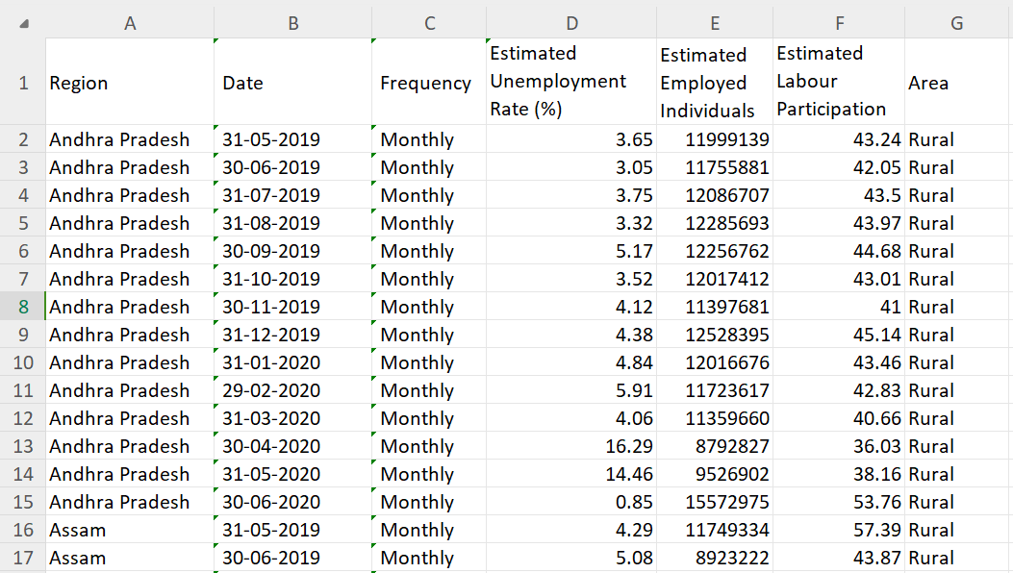

Slide 5

States : The states within India.
Date : The date when the unemployment rate was recorded.
Measuring Frequency : The monthly frequency at which measurements were taken.
Estimated Unemployment Rate : The percentage of individuals unemployed in each state of India.
Estimated Employed Individuals : The count of people currently employed.
Estimated Labour Participation Rate : The proportion of the working population (age group: 16-64 years) participating in the labor force, either employed or actively seeking employment.
Dataset Details:

Slide 6

VISUALIZATION OF DATA
& EXPLORATORY DATA ANALYSIS

Slide 7
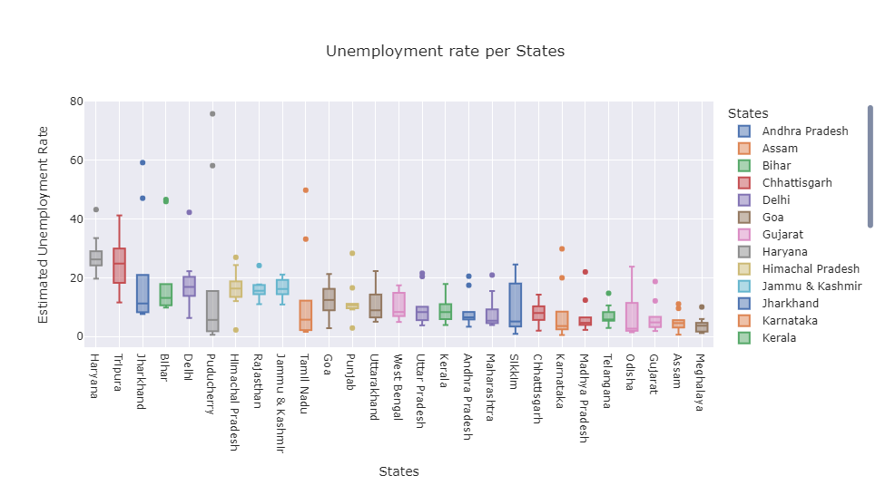

N E X T

Slide 8
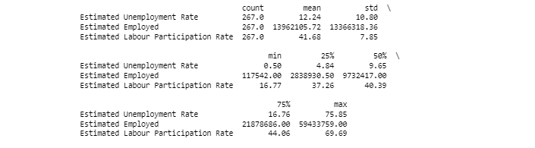
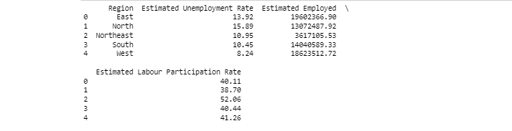
Output Analysis

Slide 9

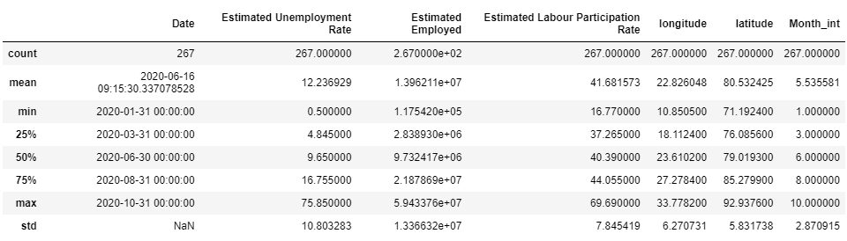
Mean estimated unemployment rate
Minimum
12.36929
0.5
Maximum
75.85

Slide 10
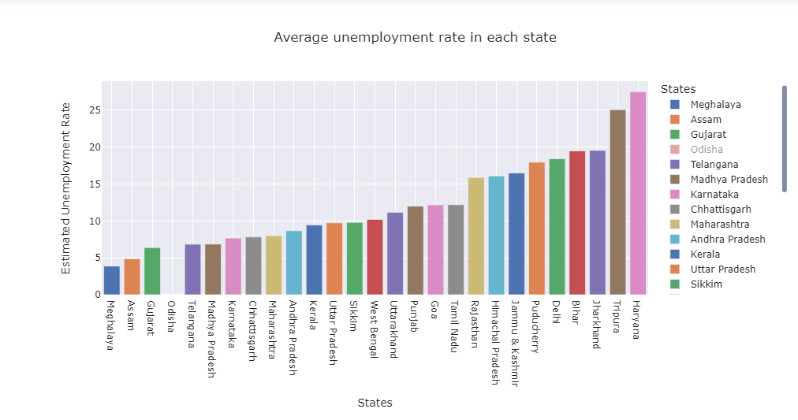


Slide 11
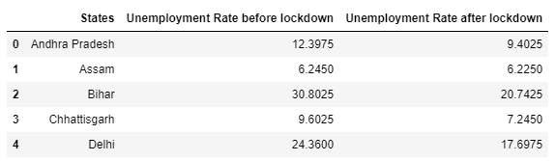
Comparison of Unemployment Rate before and after lockdown
(Displaying only top 5 rows of output)

Slide 12
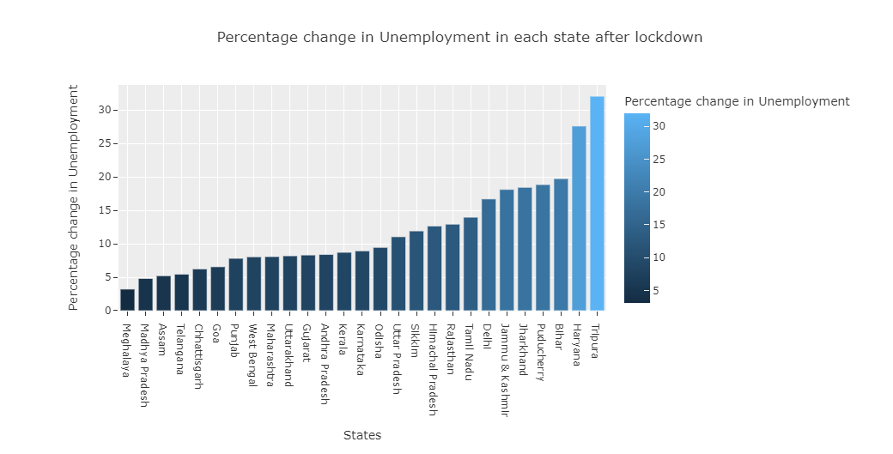


Slide 13

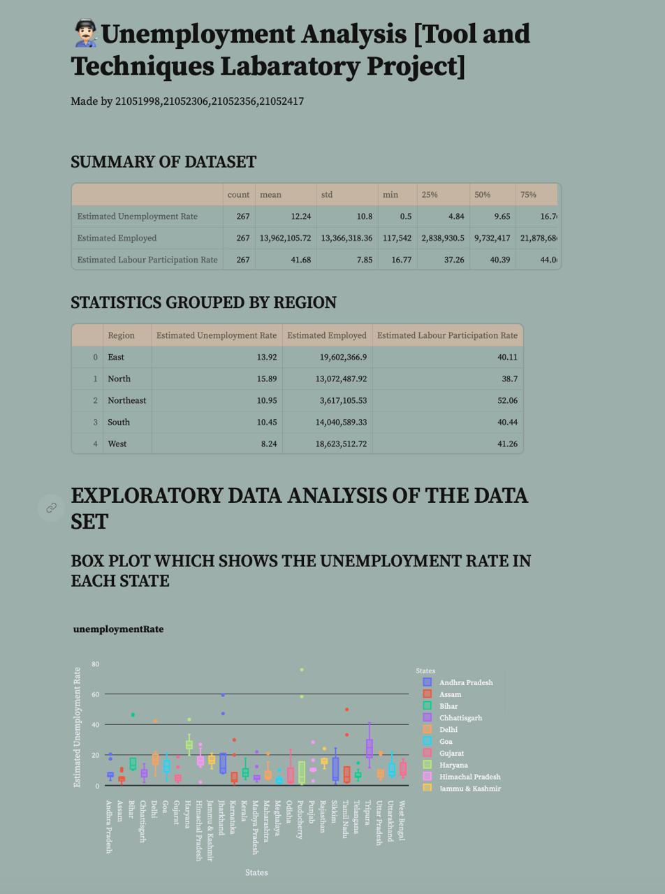
Dashboard website created using Streamlit
An overview of the entire analysis.

Slide 14
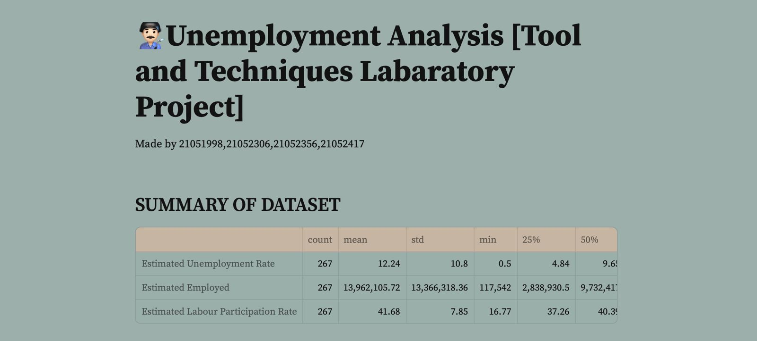

Slide 15
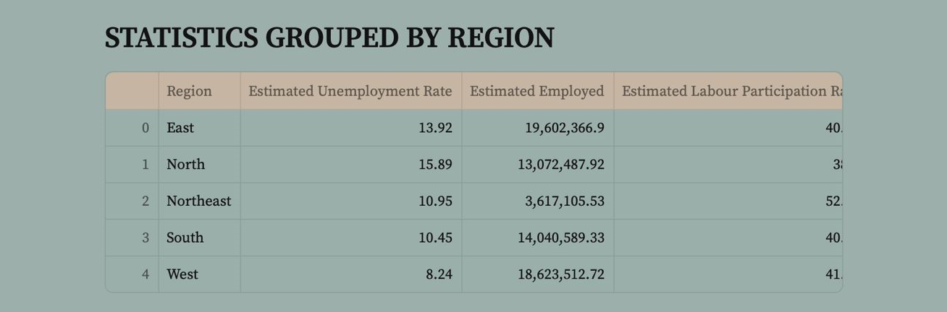

Slide 16
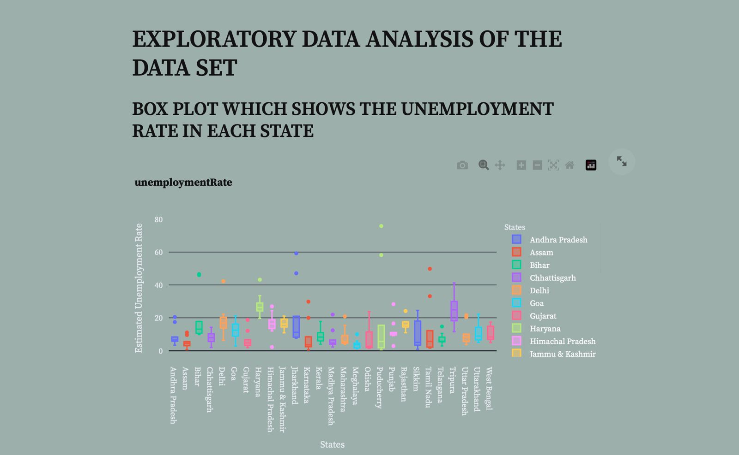

Slide 17
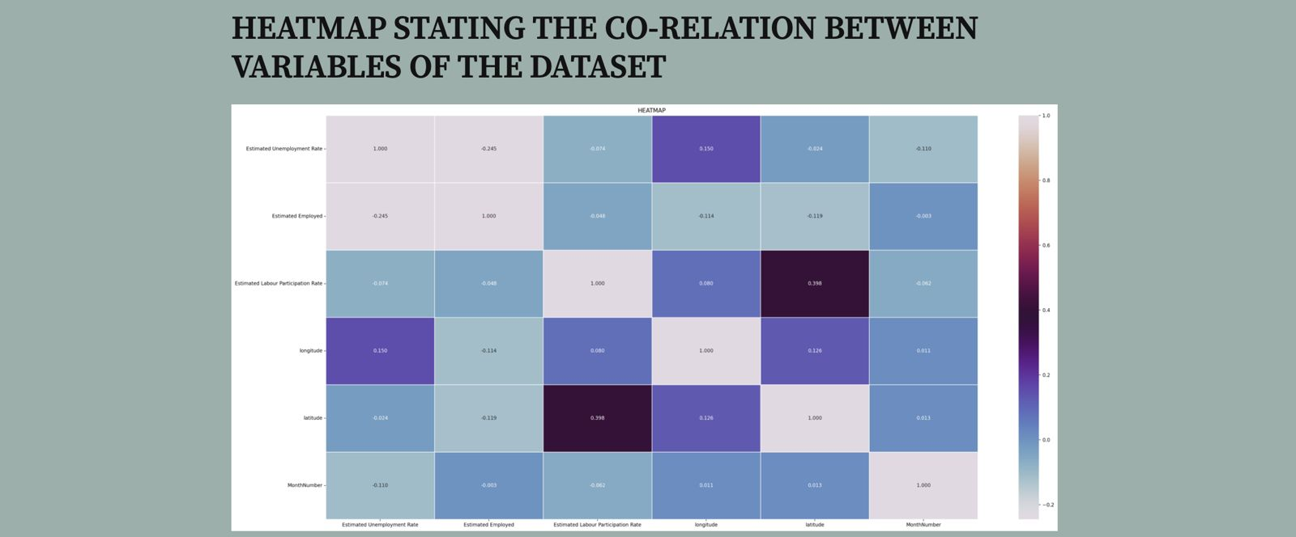

Slide 18
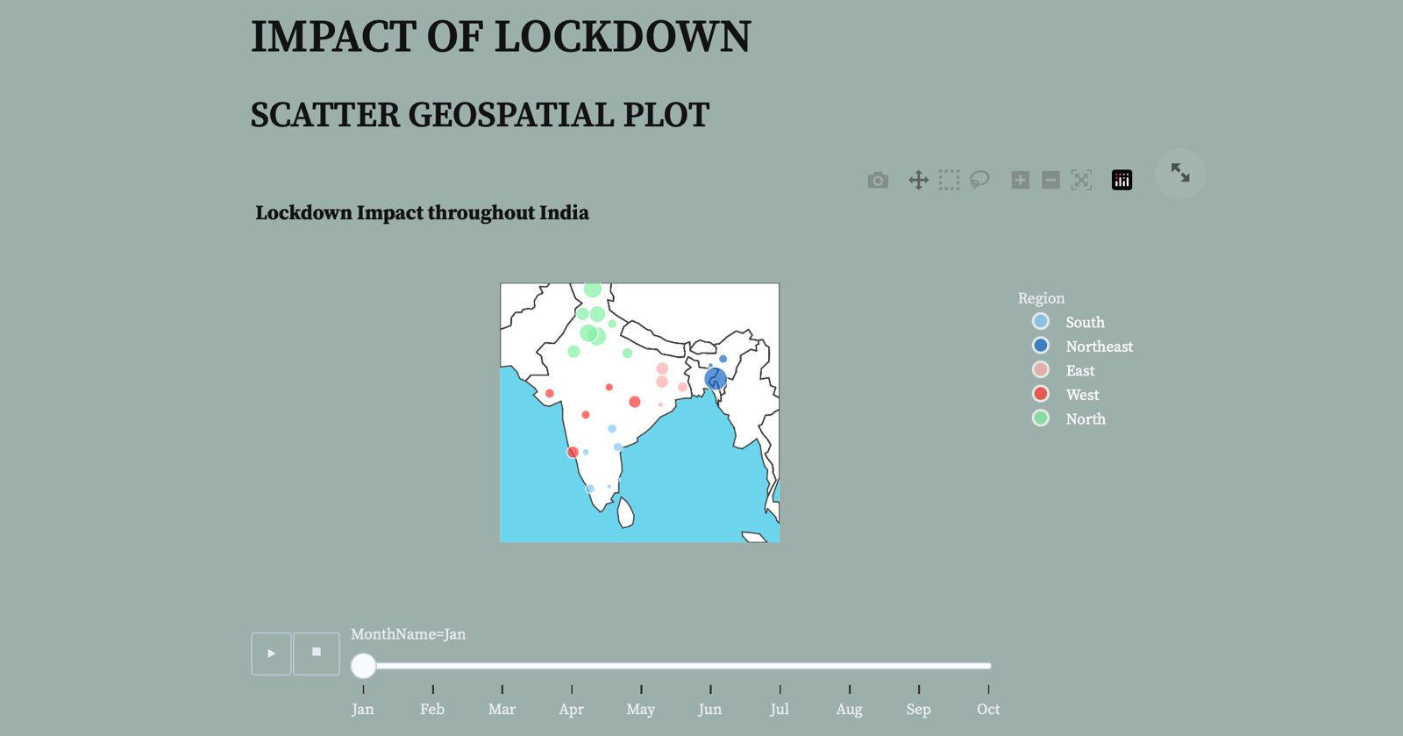

Slide 19



This analysis provides insights into the unemployment landscape across different states of India, particularly in the context of the COVID-19 pandemic.
Conclusion
The visualization highlights variations in unemployment rates among states, shedding light on areas requiring targeted interventions.
Informed policymaking based on these findings can help mitigate the impact of unemployment and facilitate the recovery of India's economy.

Slide 20

THANK YOU

